Slide 1

Telco Customer Churn Analysis and Prediction

Slide 2
Contents
Introduction
Customer Churning Trends: Unraveling the Top Insights
Machine Learning Algorithms
Model Performance
Recommendations fr Customer Retention

Slide 3
Introduction
Telecom companies aim to predict customer churn for proactive retention and improved customer loyalty.
This Presentation entails ways to identify them and provide Recommendations to retain them

Slide 4
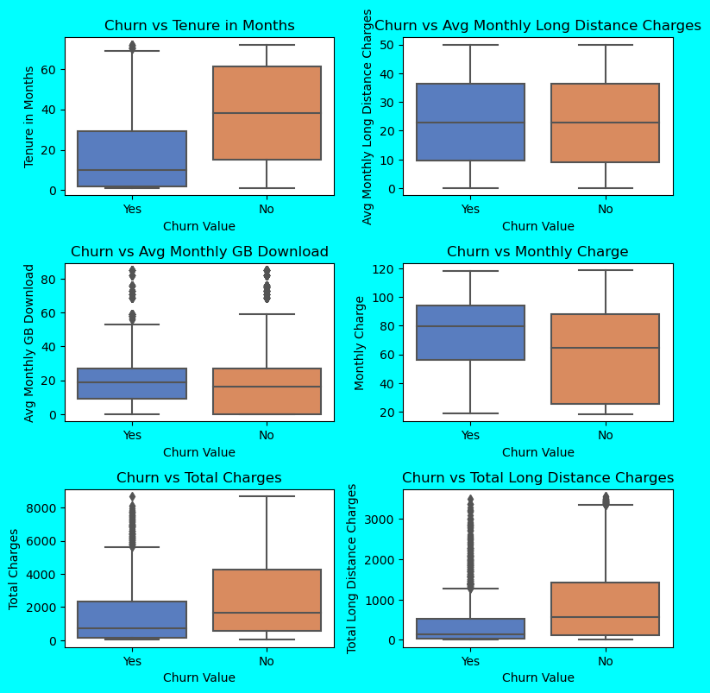
Customer Churning Trends: Unraveling the Top Insights
Customer demography: young or unmarried customers are more likely to churn
CONTRACTS: Customers with MONTHLY contracts and high monthly costs churn more
PAYMENT MODES: CUSTOMERS PAYING BY ELECTRONIC MODE CHURN MORE THAN OTHER MEANS

Slide 5
Machine Learning Models
Empowering decision-making with a lineup of predictive models to predict Customer Churn
Explored a number of Models like Logistic Regression, Decision Trees, Random Forest, XGBoost, etc to arrive at the best Model
Gradient Boosting outperformed other models and delivered the most accurate customer churn predictions

Slide 6
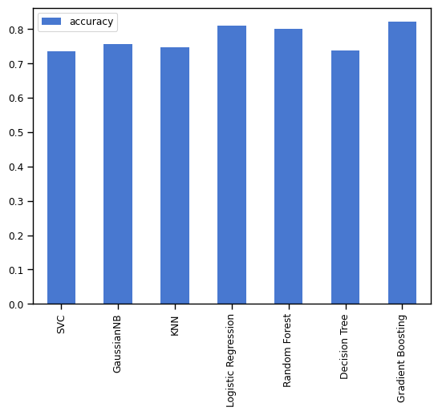
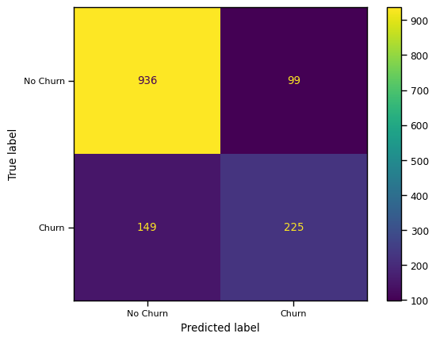
Model Performance
Accuracy
The Machine has a commendable accuracy of 82%, making reliable and precise predictions in its task.
Precision
It has an impressive precision of 82%, precisely identifying a substantial portion of true positive instances in its predictions.
Recall
The Machine captures a significant portion of actual positive instances in its predictions
Highlight
The machine's predictions are incredibly accurate and reliable across all aspects!!

Slide 7
Recommendations for Customer Retention
Personalized offers and discounts
Improved customer support and engagement
Long-term contract incentives
Targeted marketing campaigns

Slide 8

Thank You

